Slide 1

Mechanical properties
Louisiana Tech University
College of Engineering and Science
BIEN 235
Dr. Teresa Murray
Notes:
Read pp 63 – 80 in the textbook and the slides in this presentation.
For tables that have yellow highlighted text, you should know the information that is highlighted for quizzes and exams.

Slide 2
What are some of the mechanical and surface properties of materials?
Louisiana Tech University
College of Engineering and Science
How are they measured?
Spend 5 minutes with your neighbors to write list.

Slide 3
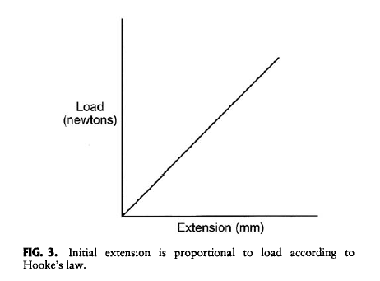
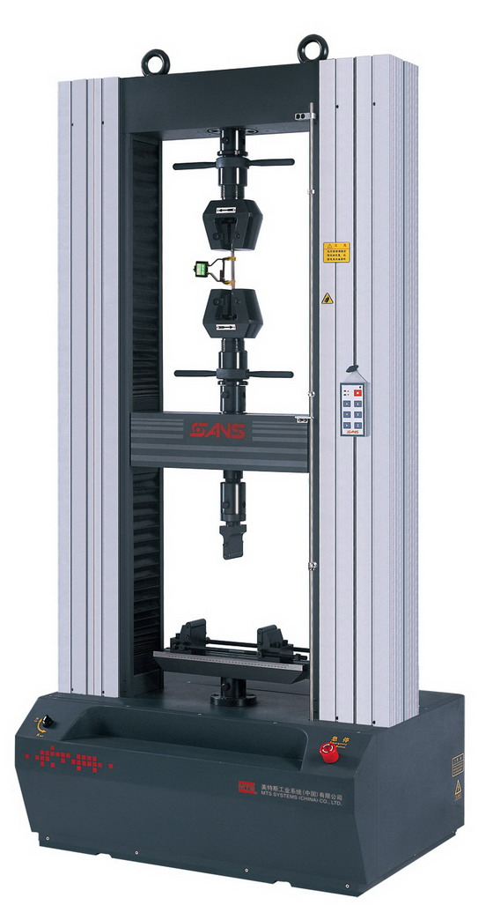
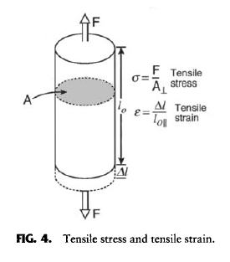


Louisiana Tech University
College of Engineering and Science
Bulk tensile properties
http://www.electrical-res.com/tensile-strength-test-equipment/
Figures from text: Ratner et al., 2004

Slide 4
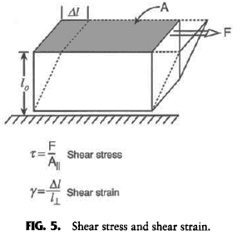
Louisiana Tech University
College of Engineering and Science
Figures from text: Ratner et al., 2004

Slide 5
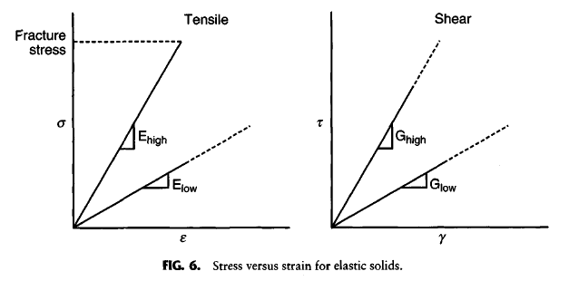
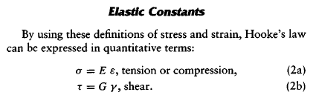
Louisiana Tech University
College of Engineering and Science
Figures and table from text: Ratner et al., 2004

Slide 6
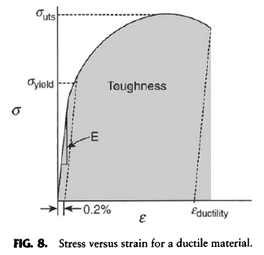
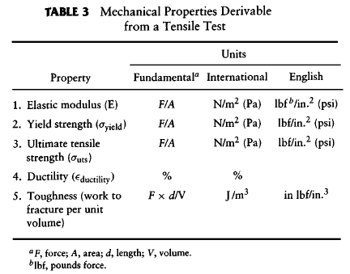
Louisiana Tech University
College of Engineering and Science
Figure and table from text: Ratner et al., 2004

Slide 7
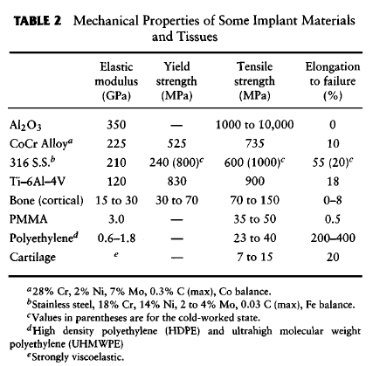
Louisiana Tech University
College of Engineering and Science
Table from text: Ratner et al., 2004

Slide 8
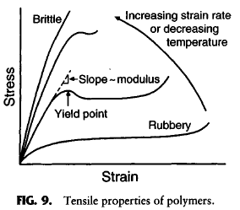
Louisiana Tech University
College of Engineering and Science
Tensile properties
Figures from Chapter 2.2, Ratner et al., 2004
Notes:
The exercise of pulling on transfer pipettes using different rates of stretching, also referred to as the strain rate, showed that plastic can stretch but that it has a tendency to break when pulled quickly. This is because a number of things are happening to the polymer chains then it is pulled. When strain is applied slowly, the bonds holding the chains together can break a little at a time, like opening a zipper or removing a Velcro strip by gently peeling back the strip a little at a time. The chains slowly straighten and the polymer part becomes longer and thinner.
If you don’t want to break your pipette as easily when you stretch it, you could heat it. Conversely, if you want it to break more easily, put it in a refrigerator for several minutes before you pull it.
This set of plots illustrates the effect of strain rate and temperature on a generic polymer. As you can see from the plot for a relatively warm polymer pulled at a slow rate, the polymer has almost no elastic region and it would be difficult to calculate an elastic modulus. (For those of you who have not yet taken the prerequisite materials course, please read about the stress-strain behavior and the elastic modulus in the textbook.) Polymers have different properties depending on their temperatures. For each polymer, there is a glass transition temperature when the polymer becomes brittle. Polymers also have a melting temperature. Why might it be important to know these temperatures when choosing polymers for a biomedical device? (Pick a student to answer the question.)

Slide 9
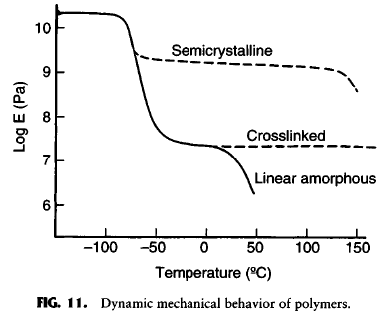
Louisiana Tech University
College of Engineering and Science
Some effects on elastic modulus
Figures from Chapter 2.2, Ratner et al., 2004
Notes:
As mentioned earlier in today’s lesson, the tensile properties of polymers are dependent on a number of factors, including temperature and degree of crystallinity. Recall that the elastic modulus (E) is the slope of the linear part of a stress-strain curve and that this is a description of how much stress a material can withstand without any permanent deformation. Stress is the force over cross sectional area with units of N/m^2, also known as pascals (Pa). (If you have not yet covered this in the prerequisite materials course, please review this in the textbook.)
This plot has the elastic modulus (E), in log scale, on the y-axis and temperature on the x-axis. (Note that body temperature is 37 degrees Celsius, or 310.15 Kelvin.) As you can see from the plot, some linear, amorphous polymers have a very low elastic modulus that rapidly decreases around and just above body temperature. Crosslinked polymers have a higher elastic modulus that does not generally decrease through a relatively large range of high temperatures. Semicrystalline polymers have an even higher elastic modulus that remains high though part of the temperature range but that can rapidly decline at temperatures used for heat sterilization. Thus, temperature and degree of crosslinking and crystallinity are important considerations when using heat sterilization of medical devices containing polymers. (Choosing (a) sterilization method(s) will be important for Project 2.)
Note, other factors also contribute to the material properties of polymers; so, this generic plot may not apply as well to a specific polymer. It is best to either look for published test data for specific polymers or to conduct tests yourself.

Slide 10
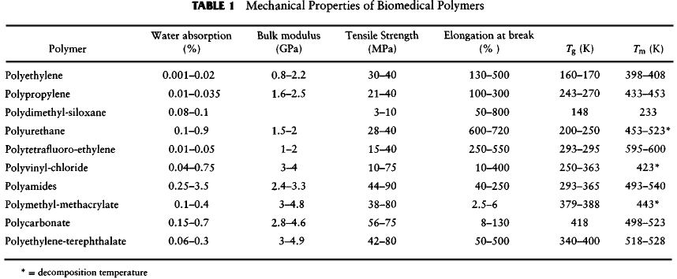
Louisiana Tech University
College of Engineering and Science
Mechanical properties
You do not need to memorize this table, but do need to know how to use it.
Figures from Chapter 2.2, Ratner et al., 2004
Notes:
This table shows the tensile strength (or sometimes referred to as the ultimate tensile strength) of several common polymers. This is the maximum force over the cross sectional area that a polymer sample can withstand before breaking. This force is applied fast enough to avoid creep. The elongation to break is dependent on how fast the part is pulled, which results in a rather large range for the “% elongation to break” property. Note that the glass transition temperature (Tg) and the melting temperature (Tm) are listed in the table. You do not need to memorize the table, but you will need to know how to use this type of table for projects and maybe a quiz or an exam or two.

Slide 11
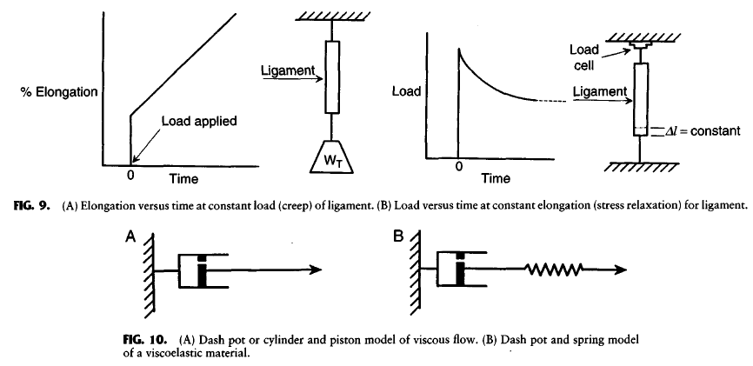
Louisiana Tech University
College of Engineering and Science
Describing the property of viscoelasticity
Figures from text: Ratner et al., 2004
Notes:
The stretching behavior of polymers can be seen in two different types of measurements. In the first type, illustrated in the upper left of this graphic, a weight is attached to a polymer sample. Immediately, the polymer will extend to some longer length. The weight is left in place and over time, the polymer stretches even further. This is one way to show the property of polymers called viscoelasticity. The immediate extension of the polymer is similar to a spring. The polymer chains can somewhat straighten out by pulling on regions that do not have many electrostatic attractions or crosslinks. If the tensile stress is immediately removed, the polymer will regain its original length. This is just like a spring. (Recall that tensile stress if the pulling force (newtons) across the cross sectional area (m^2) of a material.) If the stress is not immediately removed, then the polymer will slowly and permanently deform because the chains will rearrange. This can be represented, or “modeled” as a piston, which is also called a dash pot. Dash pots/pistons are composed of a cylinder, a piston with a small hole and a seal. When the piston is pulled, a vacuum is generated which creates a resistive force that slows the movement of the piston. The small hole in the piston allows air to slowly enter the cylinder and remove the vacuum which reduces the force of the vacuum. This is represented by the slow elongation over time in the plot in the upper left (the sloped part of the plot). In reality, the elongation is over time is not usually linear. But this plot still serves as a useful illustration of the property of viscoelasticity. The lengthening of the polymer sample refers to a viscoelastic behavior called creep.
A way to observe another viscoelastic behavior, called stress relaxation, is to attach each end of a polymer sample to a movable frame. The frame has with a load cell that measures the tensile force applied to the sample. The frame is pulled apart so that there is a relatively large tensile force on the sample. Then, the frame is left at that position for several weeks. Over time, the force on the load cell steadily decreases. Why? (Have a 2-3 min discussion in small groups or ask a student in the class to answer the question. Hint: think about the transfer pipette exercise.)

Slide 12
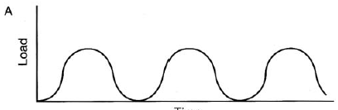
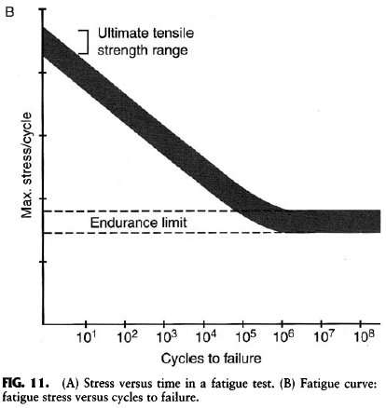
Louisiana Tech University
College of Engineering and Science
Endurance limit
X
X
X
X
X
Time
X
X
Cyclic loading to simulate years of repetitive stress
X
X
X
X
X
X
X
X
X
X
Figures from text: Ratner et al., 2004

